Slide 1
Centrifuging

Slide 2
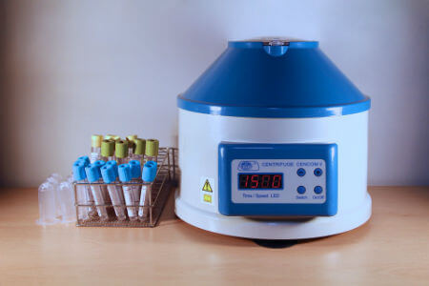
By the end of this lesson you should be able to:
Explain how a centrifuge works.
Recall what substances can be centrifuged.

Slide 3
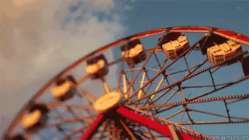
You probably know by now that spinning something quickly pushes the stuff inside it to the edge of the circle it travelled in.
For example, have you ever been on the sort of amusement park ride below? If you're going fast enough, you get pushed against your seat by the spinning machine.

Slide 4
We can use this to separate mixtures.
Heavier, denser things get pushed to the bottom of a container as it spins.
This is called centrifuging. A machine spins suspensions very quickly, sending the solids and heavy liquids to the bottom, creating layers of the different parts of the mixture.

Slide 5
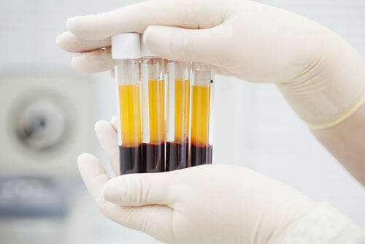
Centrifuging spins a suspension very quickly.
In general, solids will be pushed to the bottom of a centrifuged mixture.
If no solids are present, the heavier or more dense liquid will be the bottom layer.
If blood is centrifuged, the red blood cells are pushed to the bottom leaving the liquid plasma to float on top.

Slide 6
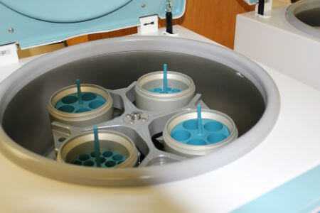
You might be thinking that the same thing can be done by gravity separation, and in most cases this is true.
But there are some suspensions that do not separate over time - like colloids.
The spinning created by centrifuging is able to push the floating particles out of a colloid! This is one of the few ways to separate a colloid.

